Slide 1
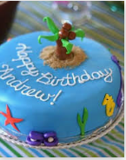
Andrews’s Surprise Birthday Party
Student’s Name
Institutional Affiliation
Course
Date

Slide 2



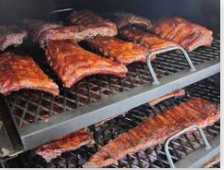
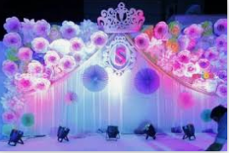
What are we creating?
Balloons.
Birthday cake.
Ice cream cone cupcakes.
Gift wrappers.
Other birthday decorations.
Barbecued beef.

Slide 3
Activities that we must do
Send invitations.
Book a DJ.
Decorate the house.
Bake the birthday cake.
Purchase the cupcakes.
Purchase gifts and gift wrappers.
Barbecue the meat.
Invite guests.
Lure the birthday honouree away from the house for the most of the day.
Shout “surprise!” when the honouree arrives.
Serve the cupcakes and drinks to the guests.
Cut the birthday cake.
Open gifts.

Slide 4

Order of Activities
Send invitation Cards.
Book the music DJ.
Lure the honouree away from the house.
Purchase drinks, cupcakes, balloons, etc.
Decorate the house.
Prepare and bake the birthday cake.
Barbecue the beef.
Call and welcome the guests.
Serve the guests.
Shout “surprise!” when the honouree arrives.
Blow the candles and cut the cake as we sing Happy Birthday.
Open gifts.

Slide 5
Timeline
Send invitation Cards. (Two weeks before the party)
Book the music DJ. (Two weeks before the party.)
Lure the honouree away from the house. (As soon as the honouree takes breakfast.)
Purchase drinks, cupcakes, balloons, decorators, party candles, beef, gifts and gift wrappers. (Between 9 and 10 am.)
Decorate the house. (Between 10 am and 1 pm.)
Prepare and bake the birthday cake. (Between 1 and 3 pm.)
Barbecue the beef. (Between 3 and 3.30 pm)
Call and welcome the guests. (Between 3.30 and 5 pm)
Serve the guests. (Between 5 and 7 pm.)
Shout “surprise!” when the honouree arrives. (Around 5.30 pm.)
Blow the candles and cut the cake as we sing Happy Birthday. (Around 5. 35 pm)
Open gifts (Between 6.30 and 7.30 pm)

Slide 6
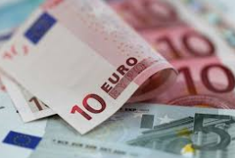
Overall Costs
Sending invitations – £1500
Birthday Cake ingredients – £200
Gifts and wrappers – £3200
Party Candles – £10
Party theme decorators – £3000
Drinks and cupcakes – £1550
Music DJ – £3500
Beef - £210
Misc. - £830

Slide 7
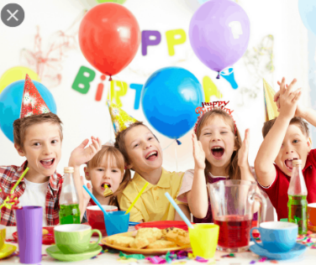
What could go beautiful?
All the guests attend.
All required items available.
Preparations go according to plan.

Slide 8
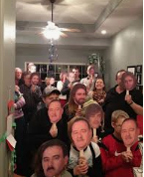
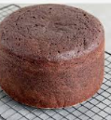
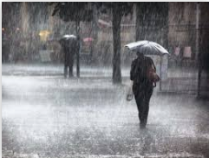
What could go horribly wrong?
Guests attend in bigger numbers than expected.
The food becomes horrible, for instance, the cake is over baked or the beef is undercooked.
The drinks run out.
It becomes rainy.
The DJ becomes committed elsewhere at the last minutes.
Notes:
Nurses use a wide range of health information technology (HIT), including electronic health records (EHRs), computerized provider order entry (CPOE), and barcode medication administration (BCMA) as part of their daily activities. These systems have the potential to increase nurses' productivity, for example, by reducing the amount of time that they spend carrying out documentation" (Moore et al., 2020, p. 799). The roles and responsibilities of an informatics nurse are, but not limited to implementing electronic medical records (EMRs), training other healthcare providers to use EMRs, offering health IT (HIT) consultations, developing health IT policies, link the IT staff with clinical nurses, develop HIT systems, project management, track the success of quality initiatives, evaluate clinical statistics, and select and prepare new technology (Darvish, Bahramnezhad, Keyhanian, & Navidhamidi, 2016).

Slide 9
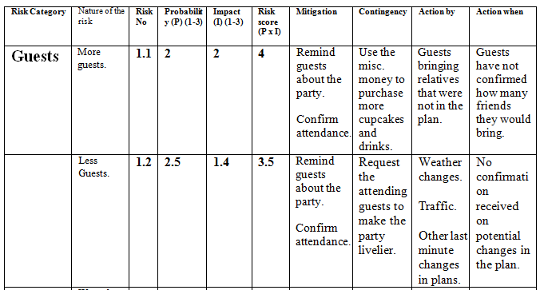
Birthday Party Risk Register: Guests

Slide 10
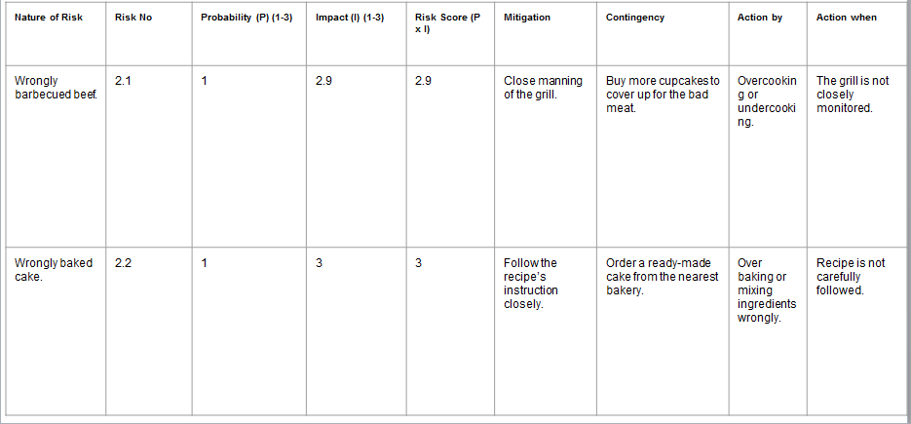
Birthday Party Risk Register: Food

Slide 11
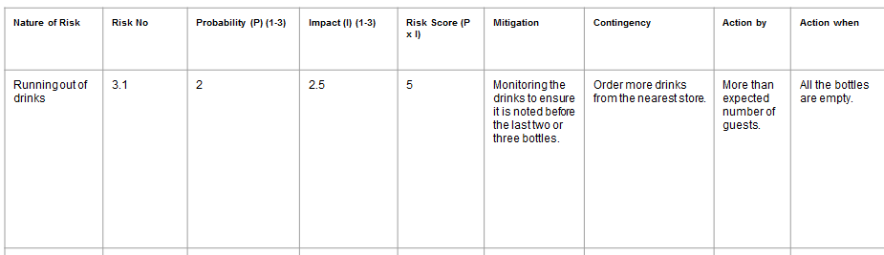
Birthday Party Risk Register: DRINKS

Slide 12
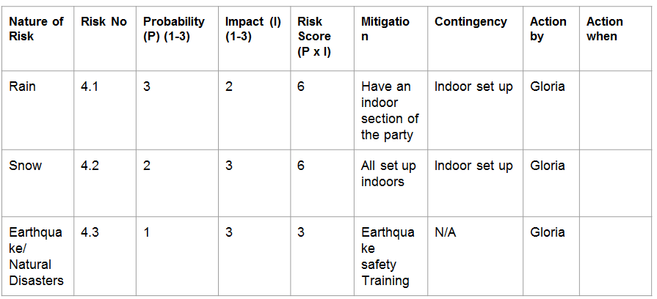
Birthday Party Risk Register: WEATHER

Slide 13
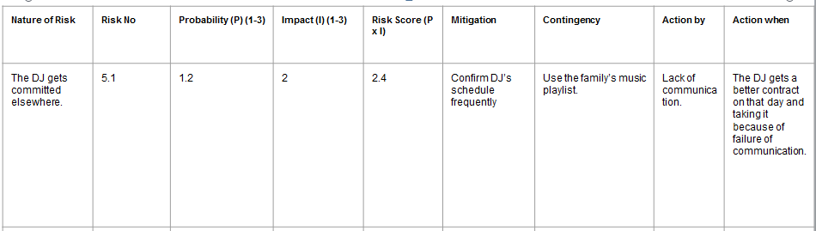
Birthday Party Risk Register: Music

